Slide 1
CSE408 Measuring of input size & running time
Lecture #3

Slide 2
Analysis of algorithms
Issues:
correctness
time efficiency
space efficiency
optimality
Approaches:
theoretical analysis
empirical analysis

Slide 3
Theoretical analysis of time efficiency
Time efficiency is analyzed by determining the number of repetitions of the basic operation as a function of input size
Basic operation: the operation that contributes most towards the running time of the algorithm
T(n) ≈ c_{op}C(n)
input size
running time
execution time
for basic operation
Number of times basic operation is executed

Slide 4
Empirical analysis of time efficiency
Select a specific (typical) sample of inputs
Use physical unit of time (e.g., milliseconds)
or
Count actual number of basic operation’s executions
Analyze the empirical data

Slide 5
Best-case, average-case, worst-case
For some algorithms efficiency depends on form of input:
Worst case: C_{worst}(n) – maximum over inputs of size n
Best case: C_{best}(n) – minimum over inputs of size n
Average case: C_{avg}(n) – “average” over inputs of size n
Number of times the basic operation will be executed on typical input
NOT the average of worst and best case
Expected number of basic operations considered as a random variable under some assumption about the probability distribution of all possible inputs

Slide 6
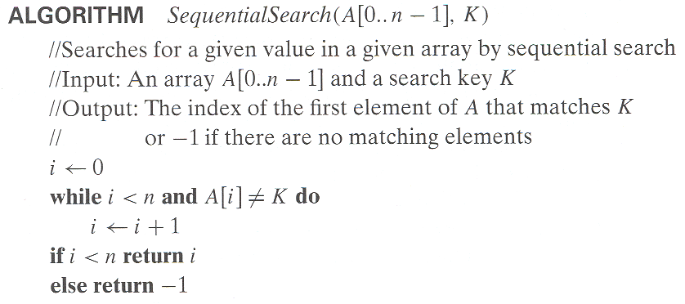
Example: Sequential search
Worst case
Best case
Average case

Slide 7
Example
Let’s consider again sequential search. The standard assumptions are that (a) the probability of a successful search is equal to p (0 ≤ p ≤ 1) and (b) the probability of the first match occurring in the ith position of the list is the same for every i.
we can find the average number of key comparisons Cavg(n) as follows. In the case of a successful search, the probability of the first match occurring in the ith position of the list is p/n for every i, and the number of comparisons made by the algorithm in such a situation is obviously i. In the case of an unsuccessful search, the number of comparisons will be n with the probability of such a search being (1− p). Therefore,

Slide 8
Types of formulas for basic operation’s count
Exact formula
e.g., C(n) = n(n-1)/2
Formula indicating order of growth with specific multiplicative constant
e.g., C(n) ≈ 0.5 n²
Formula indicating order of growth with unknown multiplicative constant
e.g., C(n) ≈ cn²

Slide 9
Order of growth
Most important: Order of growth within a constant multiple as n→∞
Example:
How much faster will algorithm run on computer that is twice as fast?
How much longer does it take to solve problem of double input size?
Notes:
Example: cn²
how much faster on twice as fast computer? (2)
how much longer for 2n? (4)

Slide 10
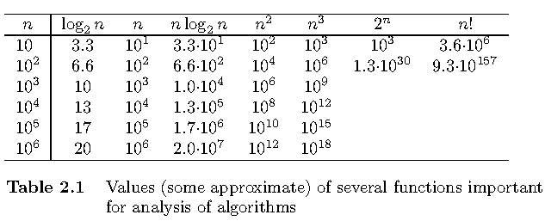
Values of some important functions as n → ∞

Slide 11



Slide 12
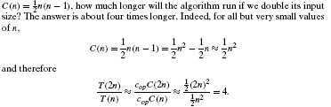

Slide 13
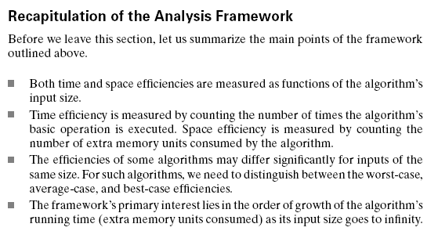
Conclusion
The efficiency analysis framework concentrates on the order of growth of an algorithm’s basic operation count as the principal indicator of the algorithm’s
To compare and rank such orders of growth, computer scientists use three notations:(big oh), (big omega), and (big theta)efficiency

Slide 14
The efficiency analysis framework concentrates
on the order of growth of an algorithm’s basic operation count as the principal indicator of the algorithm’s
To compare and rank such orders of growth, computer scientists use three notations:(big oh), (big omega), and
(big theta)efficiency

Slide 15
Thank You !!!

